Slide 1
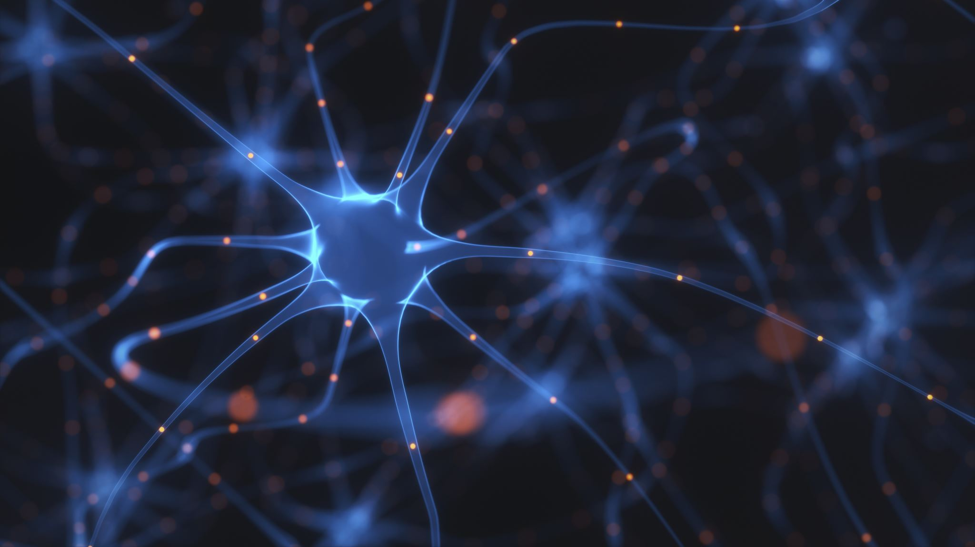
Deepfake Video Detection
Using Convolutional Neural Network and Recurrent Neural Network
AJALA Sunday Adeyinka
BETT Festus Chirchir
DEL AGUILA Gregory
LOVE Michael

Slide 2

Contents
1.0 Introduction
2.0 Methodology
2.1 Video Dataset Acquisition
2.2 Video Preprocessing
2.3 ResNeXt CNN for Feature Extraction
2.4 Bidirectional LSTM for Sequence Processing
3.0 Results and Discussion
4.0 Conclusion
1.1 What is a deepfake?
1.2 What are deepfakes used for?
1.3 How are deepfakes made?
3.1 Training and validation graphs
3.2 Evaluating the performance of the model
3.3 Problems Encountered

Slide 3


1.0 Introduction
1.0 What is a deepfake?
Deepfakes are artificial images and sounds put together with machine-learning algorithms.
1.2 What are deepfakes used for?
Scams and hoaxes.
Celebrity pornography.
Election manipulation.
Social engineering.
Automated disinformation attacks.
Identity theft and financial fraud.
The term deepfake melds two words: deep and fake. It combines the concept of deep learning with something that isn’t real.
Fake media poses an existential threat to today's societies. It can become a severe national security threat if not addressed. This report explores how Artificial Intelligence (AI) technologies can be leveraged to combat fake videos.

Slide 4
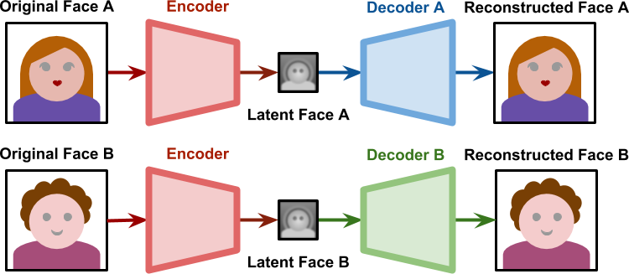
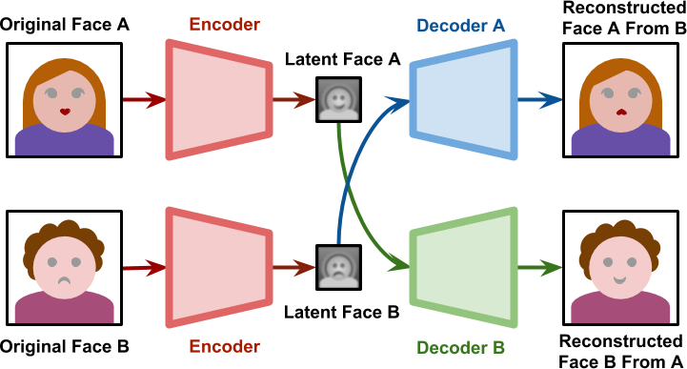
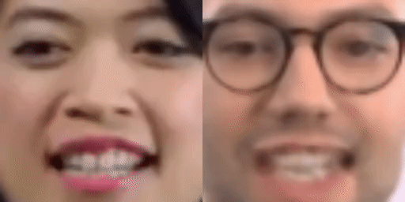
1.3 How are deepfakes made?
Deepfakes can be created in more than one way.
One system is known as a Generative Adversarial Network, or GAN, which is used for face generation
Another is an artificial intelligence (AI) algorithm known as an encoder. Encoders are used in face-swapping or face-replacement technology.
Figure 1 illustrates the Deepfake concept. Top: the training sections. Bottom: the part where images of A are decoded using the decoder of B and vice versa
Notes:
Michael

Slide 5
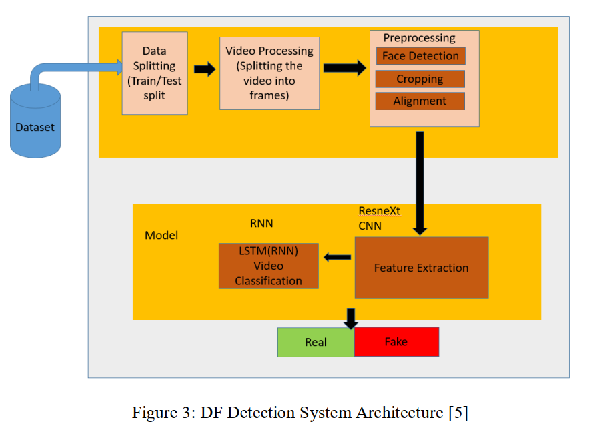
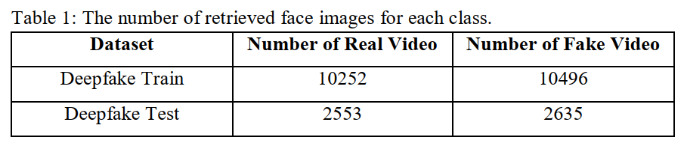
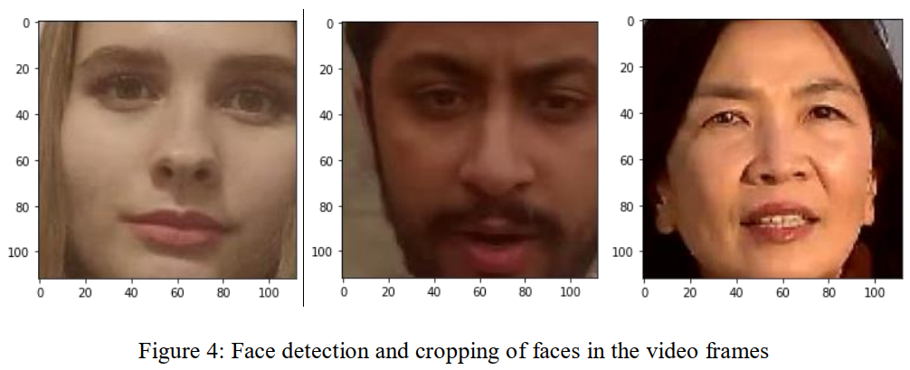
2.0 Methodology
2.1 Video Dataset Acquisition
AI Singapore Trusted Media Challenge dataset.
This dataset consists of 6934 videos (with audio), 33% real, and 67% fake.
2.2 Video Preprocessing
The extraction of the image frames from the video is the first step in preprocessing the dataset. Face detection is then performed, followed by cropping the frame to include the discovered face, as shown in Figure
Notes:
sunday

Slide 6
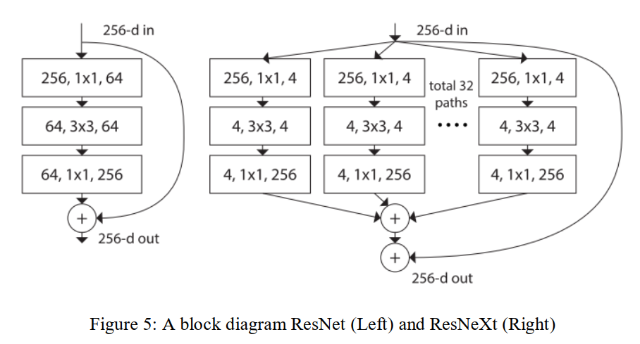
2.3 RESNEXT CNN FOR FEATURE EXTRACTION
The model is made up of ResNeXt50 32x4d followed by an LSTM layer. ResNeXt was developed by Facebook scientists and is based on the same principle as the ResNet.
The ResNeXt CNN classifier is used to extract features and recognize frame-level characteristics. After the last pooling layers, the 2048-dimensional feature vectors are used as input to the sequential LSTM
2.4 BIDIRECTIONAL LSTM FOR SEQUENCE PROCESSING
Bidirectional LSTMs are a type of LSTM that can be used to increase model performance in sequence classification issues. Bidirectional LSTMs, as depicted in figure 6, train two instead of one LSTM on the input sequence, one taking the input sequence as it is, in a forward direction, and the other a reversed copy of the input sequence in a backward direction.

Slide 7
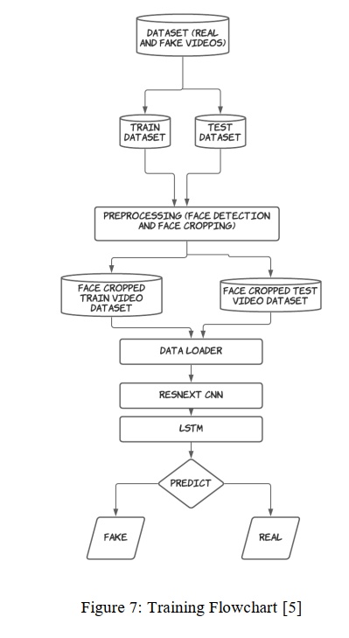
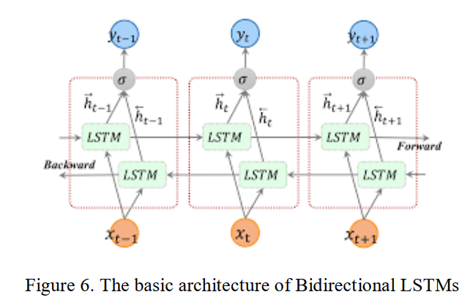
A 2048 bidirectional LSTM unit is used with a rectified linear activation unit (ReLU) function and dropout to solve this complex challenge, as it can achieve our goal.
Figure 7 shows a flowchart illustrating each of the steps taken in training the model. Weights optimization of the network is achieved with successive batches of 10 images of size 112 × 112 × 3 using an adaptive moment estimation optimizer (ADAM).​
Notes:
Sunday

Slide 8
Hyperparameters
Learning Rate: 1E-5
Epochs: 20
Dropout Rate: 0.4,0.5, 0.6
Sequence length: 20, 10, 5, 3
Activation Function: ReLu
Notes:
Gregory

Slide 9
3.0 Results and Discussion
After experimenting with different values of hyperparameters, we concluded that the ADAM optimizer with a learning rate of 1E-5 and dropout rate of 0.4 gave us the best results with an accuracy of 94.58%.
Optimizer | Epochs | Learning Rate | Dropout | Accuracy
SGD (Stochastic Gradient Descent) | 20 | 1E-5 | 0.4 | 49.4%
 |  |  | 0.5 | 63.5%
 |  |  | 0.6 | 88.1%
ADAM (Adaptive Moment estimation) |  |  | 0.4 | 94.58%
 |  |  | 0.5 | 94.37%
 |  |  | 0.6 | 94.41%
RMSprop (Root Mean Squared Propagation) |  |  | 0.4 | 93.9%
 |  |  | 0.5 | 93.5%
 |  |  | 0.6 | 93.8%
Notes:
Festus, Tune our model

Slide 10
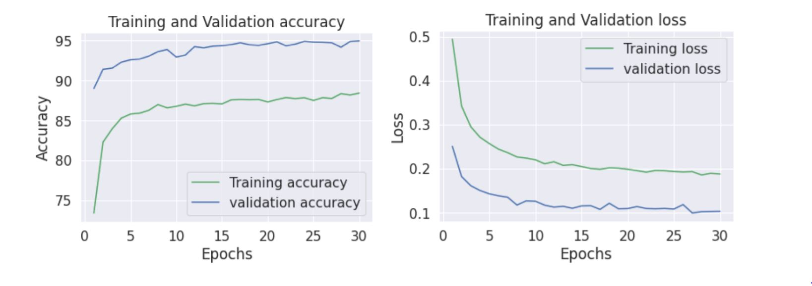
3.1 Training and validation graphs
Pro: ADAM (adaptive moment estimation)
The optimizer increases model update frequency which results in faster learning.
The noisy update process can allow the model to avoid local minimum.
Requires little memory space.
Cons
Updating the model frequently is more computationally expensive and with large dataset training may take longer.

Slide 11
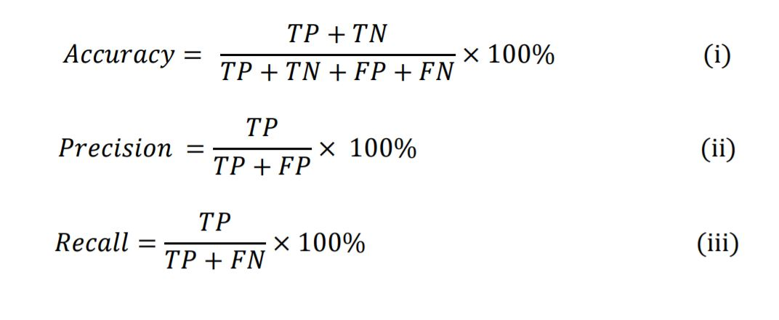
3.2 Evaluating the performance of the model
True Positive (TP)
Represents correctly predicted real videos
True Negative (TN)
Represents correctly predicted fake videos,
False Positive (FP)
Represents videos that were wrongly predicted real videos.
False Negative (FN)
Represents wrongly predicted fake videos.
Maximizing precision will minimize the number false positive (wrongly predicted real videos).
Maximizing the recall will minimize the number of false negative (wrongly predicted fake videos.)
Maximizing accuracy helps the model classify the video as either fake or real

Slide 12
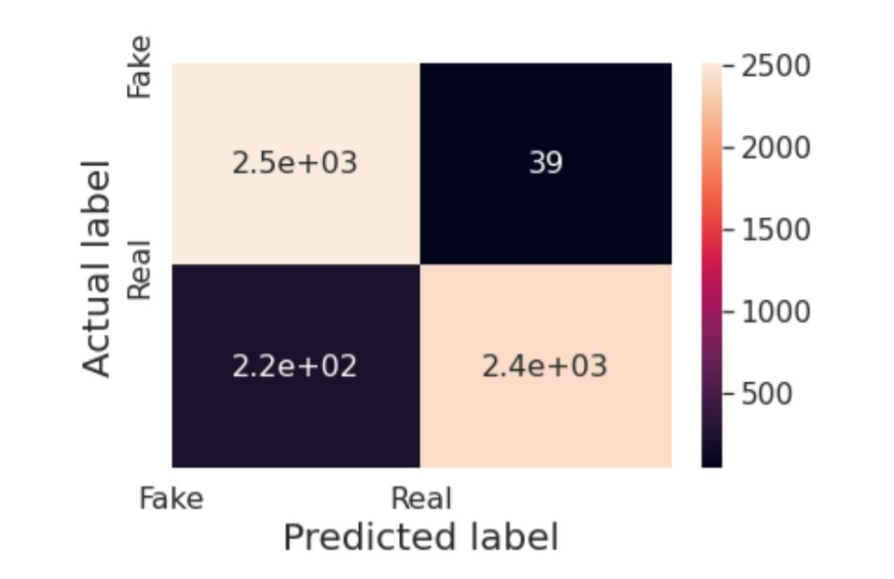
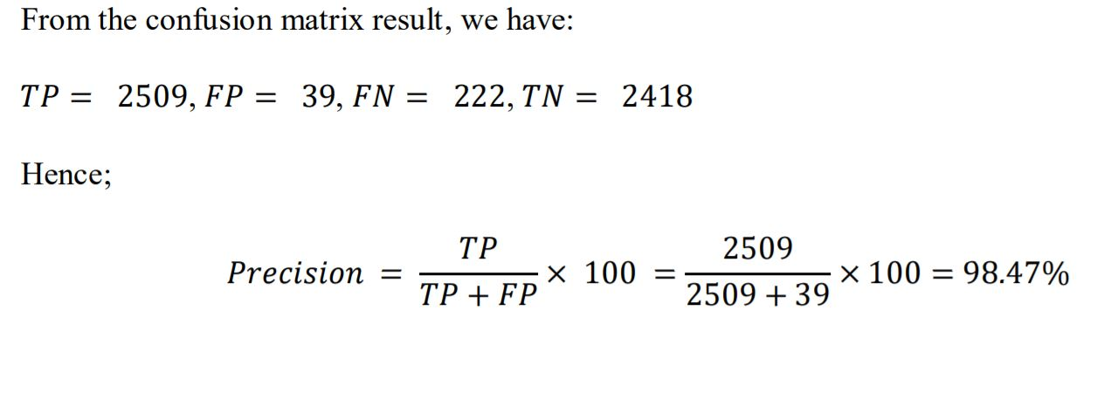
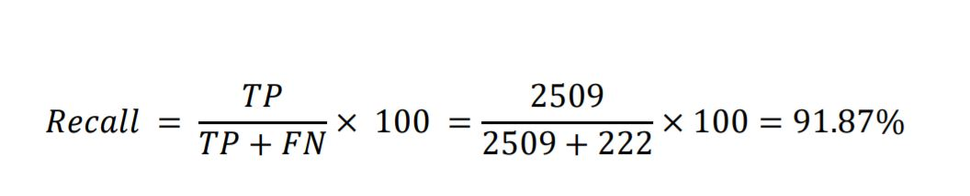
Calculation
TP
FP
FN
TN

Slide 13
Discussion
Throughout the project, some key problems was how we are going to regularize the model. We tried different dropout rates.
The optimization process may or may not find a good solution and solutions can only be compared relatively, due to deceptive local minima.
In training the optimization process may take a long time to find a satisfactory solution, due to the iterative nature of each epoch.

Slide 14
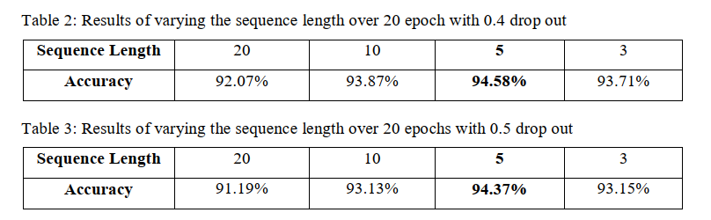
3.3 Problems Encountered
What is the best learning rate (computational time and accuracy)?
What is the optimal number of sequence length?
Notes:
Longer time does not mean better results
Sequence length: hyperparamter, the iterations of how many times

Slide 15
4.0 Conclusion
In conclusion, our findings show that in our test to determine whether a video is fake or not we reached a good accuracy score of 94.58% with the ADAM optimizer.
Our solution uses ResNeXt CNN for frame-level detection and RNN and LSTM for video classification. Based on the factors stated in the research, the suggested approach can detect whether a movie is a deep fake or not. It will deliver extremely high accuracy on real-time data.

Slide 16

Thank You for Listening

Slide 17


This Photo by Unknown author is licensed under CC BY-NC.

